Slide 1


Promoting ORCID Adoption in the Academic Institutional Ecosystem: Progress Reports from Adoption & Integration Partners
Violeta Ilik
Texas A&M University
VIVO Conference August 6-8, 2014 Austin, TX

Slide 2
What is the ORCID project at Texas A&M?
University program to integrate standard author identifiers into the profiles of all Texas A&M faculty, graduate students, and staff
Aimed first at graduate students and post-docs
Others can participate on request

Slide 3
Build Support
Graduate School
Central Information Office
Provost
Dean of Faculties
Vice President for Research
Human Resources
Registrar Office
Library – that’s us!!!

Slide 4
Communication challenges
Unique to ORCID?
Not really – institutions implementing VIVO face same challenges:
consulting with and educating faculty about the value of VIVO

Slide 5

©TEUN HOCKS
Notes:
What is ORCID? What is VIVO? Identifier vs Profile – what? Semantic Web ??? Linked Data ???

Slide 6
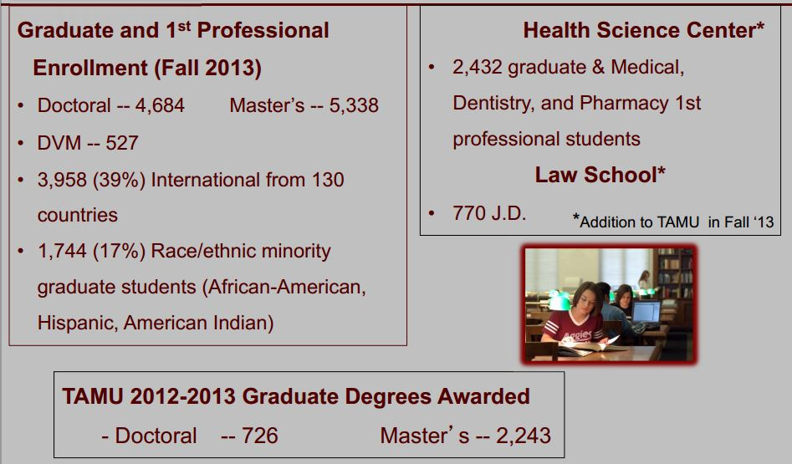
Butler-Purry K., “Why ORCID @ Texas A&M University?“ ORCID Outreach Meeting, May 2014, Chicago, IL
Notes:
Associate Provost for Graduate and Professional Studies gave some numbers from last academic year and stressed that
Texas A&M University has been exploring various means for tracking career outcomes and impact of scholarship of graduate students • Currently limited student level data is available –Accredited graduate programs –NSF Survey of Earned Doctorates (SED) data –AAU Data Exchange –Academic Analytics

Slide 7
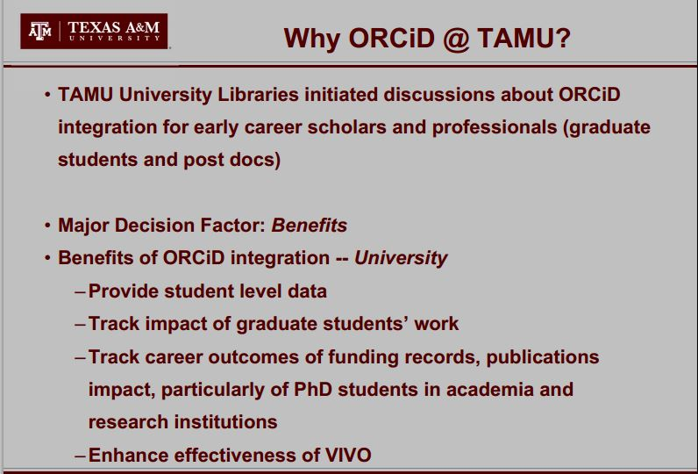
Butler-Purry K., “Why ORCID @ Texas A&M University?“ ORCID Outreach Meeting, May 2014, Chicago, IL
Notes:
Biggest concern was compliance with (FERPA), the federal regulation protecting the privacy of student education records. FERPA compliance issues were addressed when the Associate Vice Provost for Graduate & Professional Studies determined that ORCIDs were mandatory for graduate students to facilitate University business processes, including fulfilling the University’s obligations to publicly disseminate graduate theses, dissertations, and enabling the University to effectively track and assess graduate student outcomes over time.
Benefits of ORCiD integration – Graduate Students –As early career professionals, able to maintain full scholarly records over career –Prepare graduate students for managing their scholarly identity with training • Other Major Decision Issues –Mandatory or Optional Student Adoption –All graduate students or PhD students only.

Slide 8

Plan for Integration of ORCiDs
Clear policy hurdles with University administration
Join ORCiD for access to API and Tech support
Mint ORCiDs for 10,000+ graduate students
Conduct outreach and training to support new and existing ORCiD owners
Integrate ORCiDs into key information systems
Develop ORCiD app for sustainable management of ORCiDs
Expand program to cover faculty and research staff – next on agenda

Slide 9
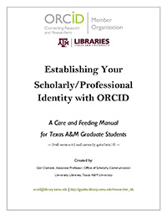
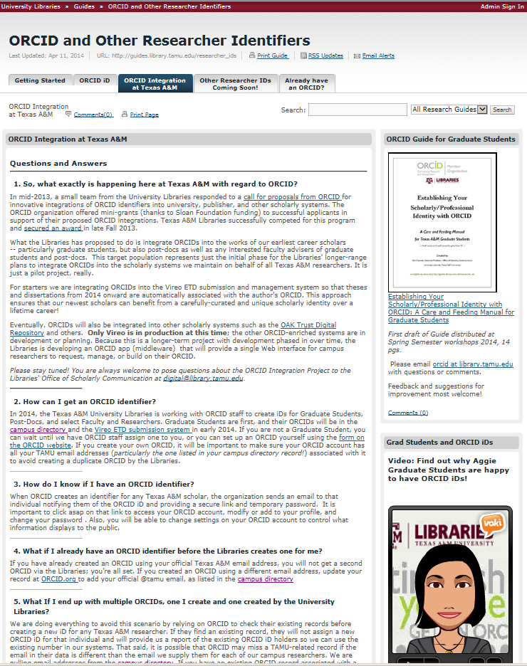
Gail Clement conducts outreach and training to support new and existing ORCiD owners
Notes:
University Libraries • Develops outreach materials, conducts presentations and trainings, IT development including integration into student records, etc. • Current Graduate Students Transition • New Graduate Students

Slide 10
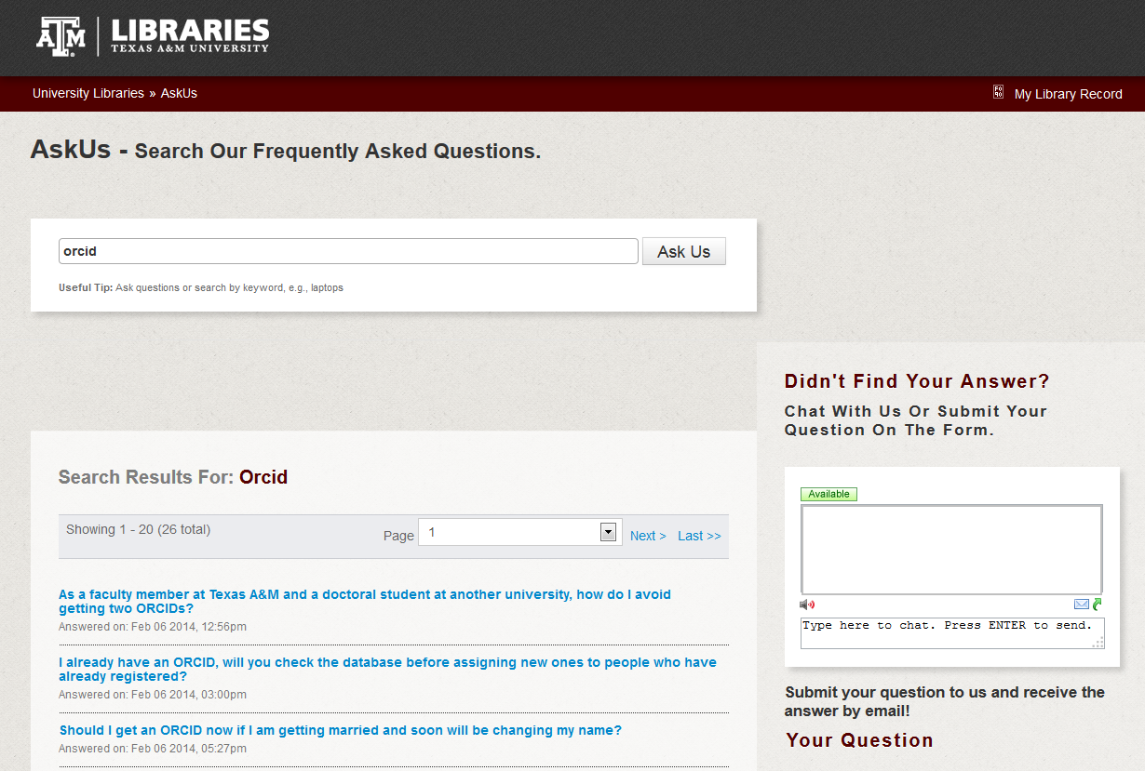
Integration with Library Public Services

Slide 11
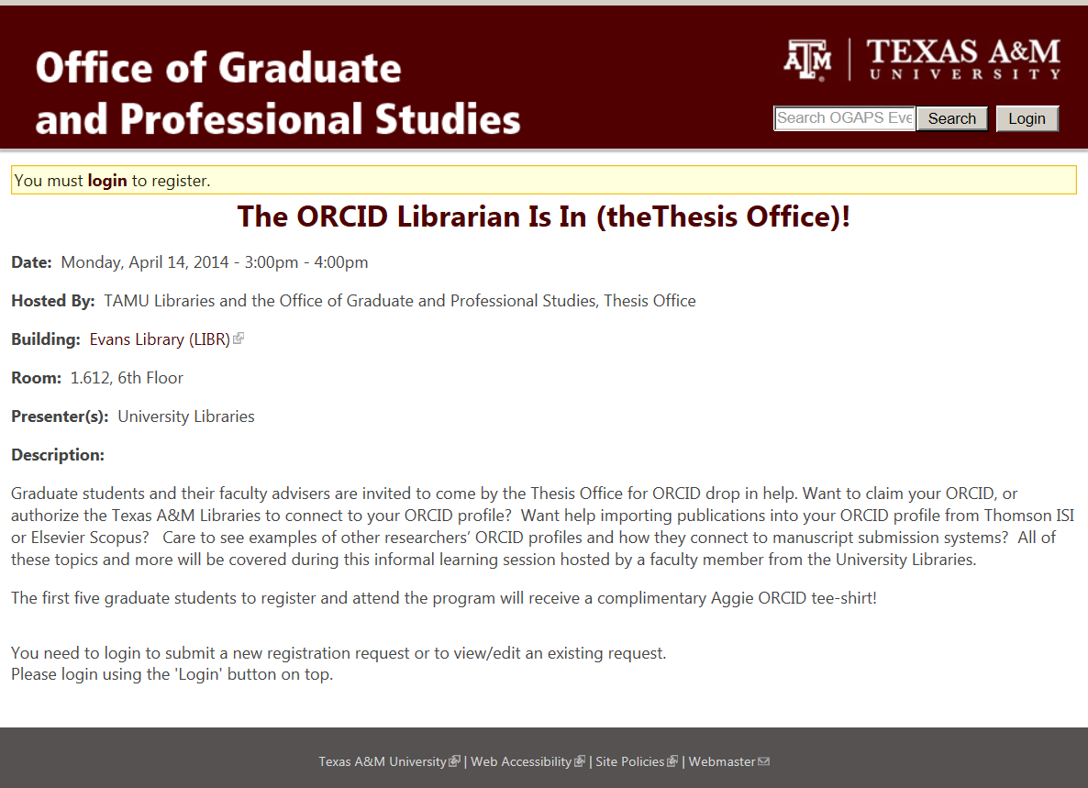
Integration with Graduate School Service

Slide 12
Library Geeks to Campus Geeks
Everyone knew placing ORCiD in the campus directory (LDAP) made sense.
Campus IT was excited about the project and were immediately on-board!
Except for one thing…
Campus IT was extremely busy and wouldn’t be able to help with the project anytime soon.

Slide 13
Digital Initiatives IT staff
Need of two distinct applications:
One application to process graduate students and create their ORCiDs
Another application for the ongoing support and integration into other applications – VIVO included
Notes:
Programmers on the project team developed an ORCID management application in order to capture, maintain, update, and export ORCID data, and to provide user services such as look-up, merging duplicate identifiers, or minting new ones. Library maintains master file of campus ORCIDs, with capabilities to push ORCID data to other campus systems including VIVO.

Slide 14





Process Workflow
©Douglas Hahn
TAMU uses API to create new ORCiD with Last, First, email
Email sent to patron with information about ORCiD
Patron goes to ORCiD to claim ID and add additional info
TAMU asks for READ limited to patron account
TAMU stores token with READ access for later use

Slide 15
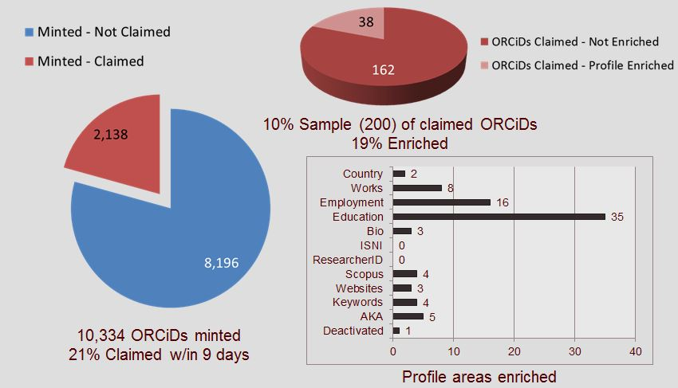

Slide 16



ORCiDs in VIVO@TAMU
LDAP
LIBRARY’s ORCiD app
VIVO
© Violeta Ilik

Slide 17
ORCiDs in VIVO@TAMU
Modeling LDAP feed via Karma data integration tool
Customizing Person Template via Harvester

Slide 18
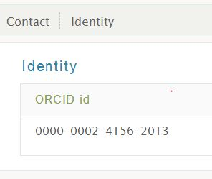
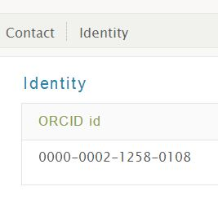
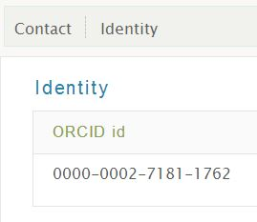
Integrating ORCiDs into VIVO
ORCiDs for graduate students are currently in the VIVO @ TAMU platform

Slide 19
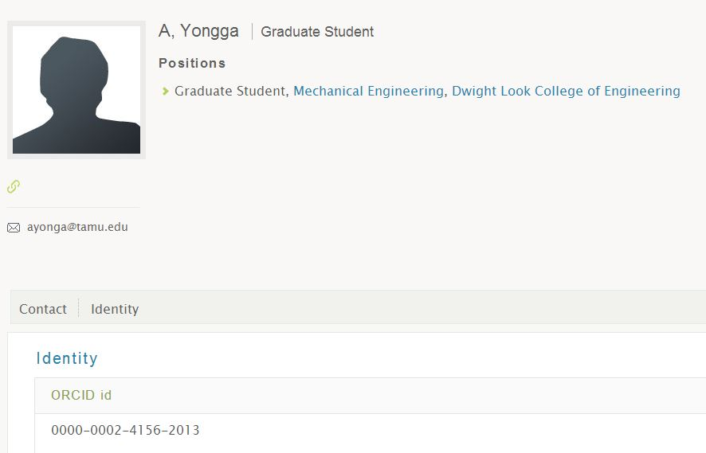
Where are the publications from ORCiD in our VIVO?

Slide 20
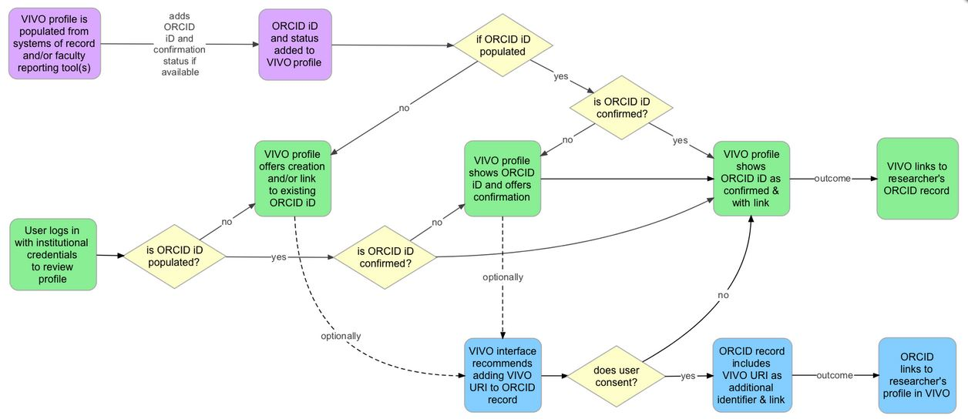
Waiting for VIVO 1.7?
© Jonathan Corson-Rikert
Notes:
Cornell University’s ORCID Adoption and Integration grant supports integration of ORCID iD creation and confirmation into the VIVO open source researcher profiling system. first at Cornell and then in VIVO source code available to other VIVO users. The ORCID iD has been included as an identifier in the VIVO ontology since VIVO 1.0, and version 1.7 of VIVO will support creation and confirmation of ORCID iDs within the VIVO application itself.
ORCID property in vivo 1.6 ontology has changed from data to object property. This change is so that we can support a connection to ORCID to validate the iD — at this time for me at least a more complex, but a better path going forward.

Slide 21
References:
Butler-Purry K., “Why ORCID @ Texas A&M University?“ ORCID Outreach Meeting, May 2014, Chicago, IL
Clement, G., Tucker, S., Ilik, V., Hahn, D., Cooper, M., “It Takes a Village to Grow ORCIDs on Campus: Establishing and Integrating Unique Scholar Identifiers at Texas A&M” Texas Conference on Digital Libraries, Austin, TX, April 28, 2014 – April 29, 2014
Clement, G. and Hammons, L., 2014, “Establishing Scholarly Identity by Graduate Students: Results of the ORCID-ETD Integration Project at Texas A&M University,” ETD2014, the 17th International Symposium on Electronic Theses & Dissertations, Networked Digital Library of Theses and Dissertations, Leicester, England, 23 July to 25 July 2014.
Ilik, Violeta (2014). “Supporting a scholar’s online identity with VIVO and ORCiDs.” Texas STEM Librarians ‘Conference, College Station, TX. Available electronically from
http://oaktrust.library.tamu.edu/bitstream/handle/1969.1/152132/IlikTexasSTEM.pdf?sequence=1
ORCID. "Timeline for creating ORCID iDs via the API" http://support.orcid.org/knowledgebase/articles/321374-timeline-for-creating-orcid-ids-via-the-api
Wiki DuraSpace, May 2014. "VIVO-ORCID Integration for VIVO v1.7" https://wiki.duraspace.org/display/VIVO/VIVO-ORCID+Integration+for+VIVO+v1.7

Slide 22
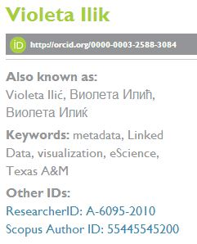
Thank you!
Violeta Ilik vilik@library.tamu.edu

